Slide 1
Socket Programming in C
Dr. Asif Uddin Khan

Slide 2
Questions that will be Addressed
What mechanisms are available for a programmer who writes network applications?
How to write a network application that sends packets between hosts (client and server) across an IP network?
Answer: socket API
IP Network
Client
Server

Slide 3
Layers of the TCP/IP Protocol Suite
Application Layer
e.g. ftp
Application Layer
Transport Layer
e.g. TCP, UDP
Transport Layer
Network Layer
e.g. IP
Network Layer
Link Layer
Ethernet
Link Layer

Slide 4
Protocol Suite Location
Internet Protocol Layer
Location
Application Layer
Applications (e.g. browser, game, ftp)
Application Programming Interface (API) (e.g. network API)
Operating System (e.g. Unix)
Transport Layer (TCP, UDP)
Network Layer (IP)
Interface to the Network Card
Network Card &
Device Driver (e.g. Ethernet card)
Link Layer

Slide 5
Network API
Operating system provides Application Programming Interface (API) for network application
API is defined by a set of function types, data structures, and constants
Desirable characteristics of the network interface
Simple to use
Flexible
independent from any application
allows program to use all functionality of the network
Standardized
allows programmer to learn once, write anywhere
Application Programming Interface for networks is called socket

Slide 6
Sockets
Sockets provide mechanisms to communicate between computers across a network
It is an interface between application process and transport layer.
There are different kind of sockets family
DARPA Internet addresses (Internet Sockets)
Unix inter process communication (Unix Sockets)
CCITT X.25 addresses
and many others

Slide 7
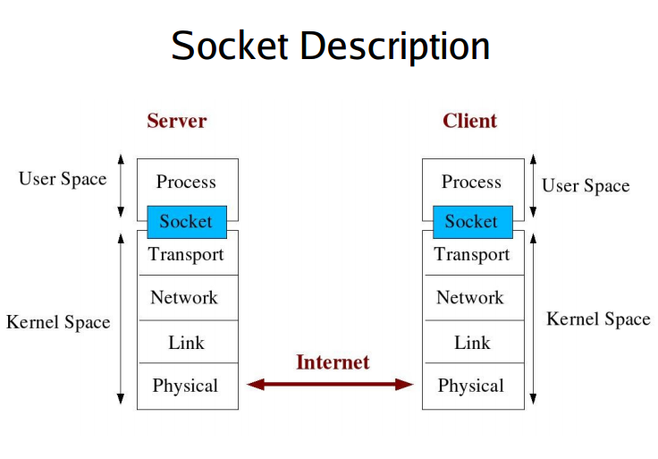

Slide 8
Socket Types
Stream Sockets: Delivery in a networked environment is guaranteed. They are connection oriented
Datagram Sockets: Delivery in a networked environment is not guaranteed. They are connectionless.

Slide 9
Naming and Addressing a host in network
Host name
identifies a single host
variable length string
is mapped to one or more IP addresses
IP Address
written as dotted octets (e.g. 10.0.0.1)
32 bits. Not a number! But often needs to be converted to a 32-bit to use.
Port number
identifies a process on a host
16 bit number

Slide 10
Structures used in Socket API of C
sockaddr: Holds the socket information
sockaddr_in: Helps in referencing to the socket's elements
in_addr: Holds 32 bit netid/hostid
hostent: Used to keep information related to host
servent: Used to keep information related to service and associated ports
Notes:
Socket address structures are an integral part of every network program. We allocate them, fill them in, and pass pointers to them to various socket functions. Sometimes we pass a pointer to one of these structures to a socket function and it fills in the contents.
We always pass these structures by reference (i.e., we pass a pointer to the structure, not the structure itself), and we always pass the size of the structure as another argument.
When a socket function fills in a structure, the length is also passed by reference, so that its value can be updated by the function. We call these value-result arguments.
Always, set the structure variables to NULL (i.e., '\0') by using memset() for bzero() functions, otherwise it may get unexpected junk values in your structure.

Slide 11
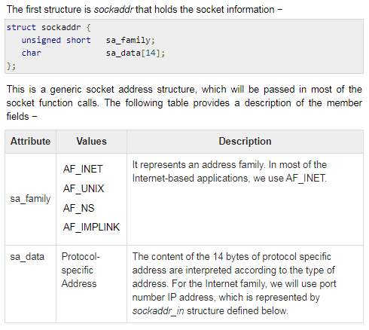
sockaddr

Slide 12
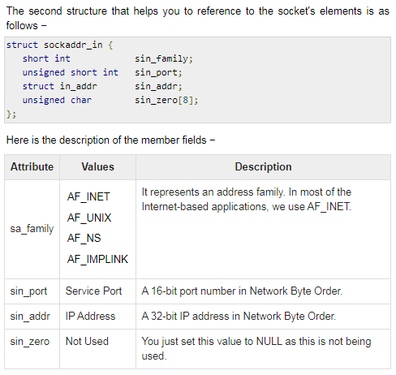
sockaddr_in

Slide 13
in_addr
Used only in the structure “sockaddr_in” as a structure field and holds 32 bit netid/hostid.
struct in_addr {
unsigned long s_addr; };
Holds a 32-bit IP address in Network Byte Order.

Slide 14
hostent
Used to keep information related to host
struct hostent {
char *h_name;
char **h_aliases;
int h_addrtype;
int h_length;
char **h_addr_list
#define h_addr h_addr_list[0]
};

Slide 15
Description
Attribute | Values | Description
h_name | abc.com etc. | It is the official name of the host. For example, abc.com, google.com, etc.
h_aliases | TI | It holds a list of host name aliases.
h_addrtype | AF_INET | It contains the address family and in case of Internet based application, it will always be AF_INET.
h_length | 4 | It holds the length of the IP address, which is 4 for Internet Address.
h_addr_list | in_addr | For Internet addresses, the array of pointers h_addr_list[0], h_addr_list[1], and so on, are points to structure in_addr.
Notes:
NOTE − h_addr is defined as h_addr_list[0] to keep backward compatibility.

Slide 16
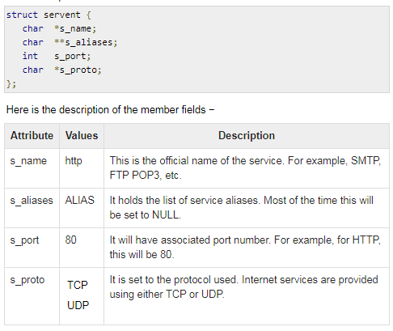
servent
Used to keep information related to service and associated ports.

Slide 17
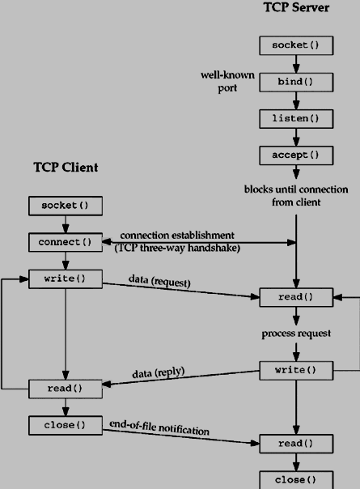
TCP client and server

Slide 18
Necessary Functions
socket: This call returns a socket descriptor that you can use in later system calls or -1 on error.
bind: This function assigns a local address to a socket. The address is the combination of IP address and port number. This function is called by TCP server only.
listen: The listen function is called only by a TCP server. It allows the kernel to accept incoming connection.
connect: It is used by a TCP client to establish a connection with a TCP server.
accept: The accept function is called by a TCP server to accept the incoming connection requests.
read: for reading data
Write: For sending data
Close: For closing connection
bzero: This function is used to set all the socket structures with null values.

Slide 19


Necessary Functions
write: The write function attempts to write nbyte bytes from the buffer pointed by buf to the file associated with the open file descriptor, fildes.
read: The read function attempts to read nbyte bytes from the file associated with the buffer, fildes, into the buffer pointed to by buf.
scanf("%d",&num1);
n1=write(sockfd,&num1,sizeof(int));
if (n1 < 0) {
perror("ERROR in writing");
exit(1);
}
n1 = read(sock,&num1,sizeof(int));
if (n1 < 0) {
perror("ERROR reading from socket");
exit(1);
}

Slide 20
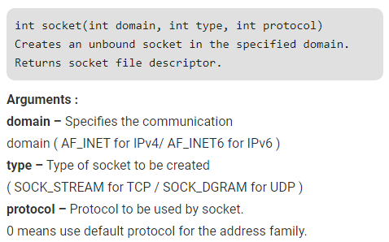
“socket” functions
Header file
#include <sys/types.h> #include <sys/socket.h>
Example:
sockfd = socket(AF_INET, SOCK_STREAM, 0);
if (sockfd < 0)
{ perror("ERROR opening socket");
exit(1); }

Slide 21
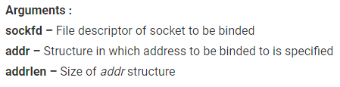
“bind” function
Assigns address to the socket.
int bind(int sockfd, const struct sockaddr *addr, socklen_t addrlen)

Slide 22
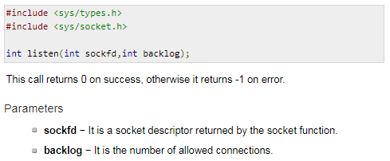
The listen Function

Slide 23
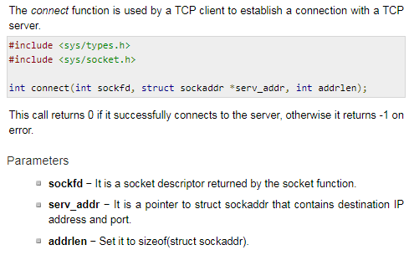
The connect Function

Slide 24
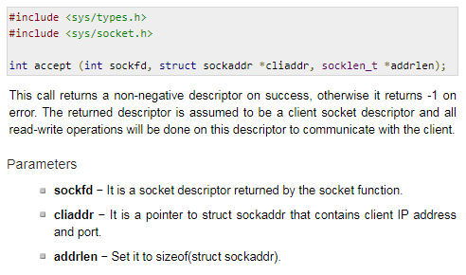
The accept Function

Slide 25
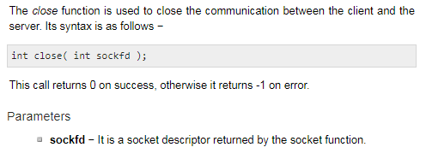
The close Function

Slide 26
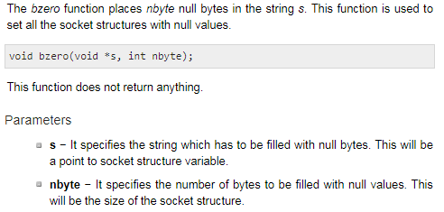
The bzero Function

Slide 27
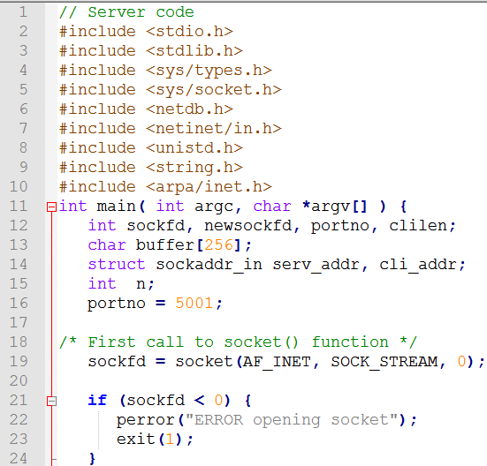
First tcp socket program using c Server code

Slide 28
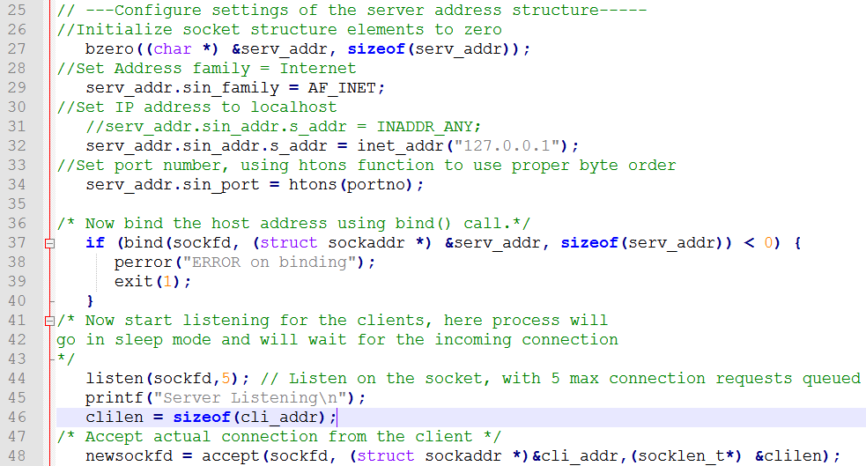

Slide 29
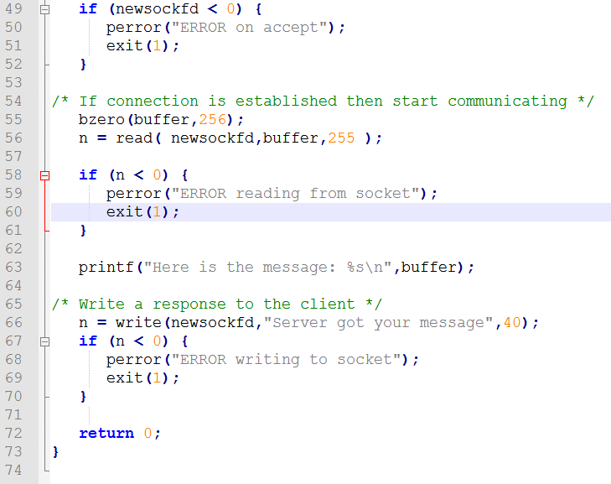

Slide 30
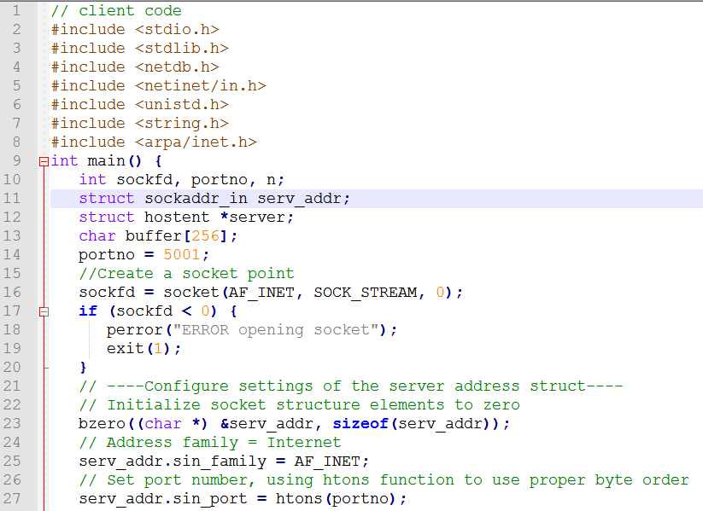
Client code

Slide 31
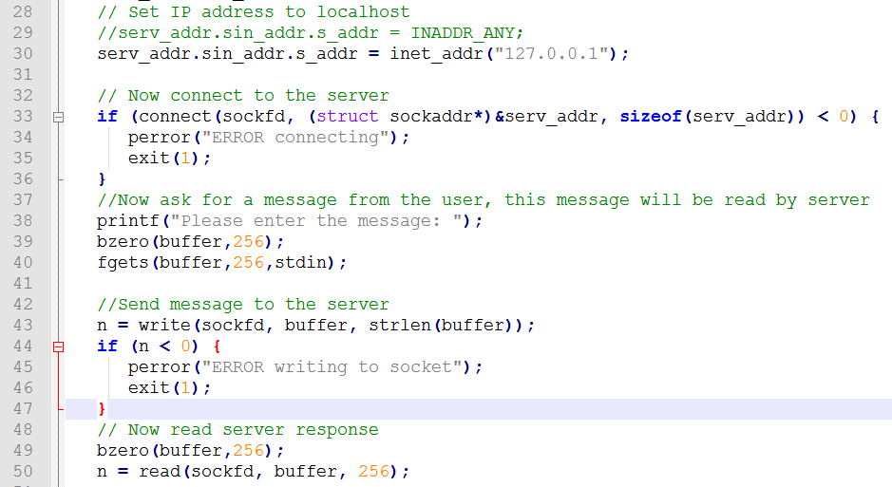

Slide 32
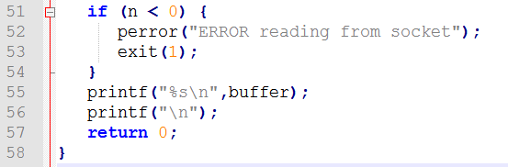

Slide 33
Running
Different directory
Server(server.c)
g++ server.c
./a.out
Client(client.c)
g++ client.c
./a.out 127.0.0.1 5001
==================or=======
Same directory
.g++ server.c –o server
./server
g++ client.c –o client
./client 127.0.0.1 5001

Slide 34
References
https://www.tutorialspoint.com/unix_sockets/index.htm
http://home.iitk.ac.in/~chebrolu/ee673-f06/sockets.pdf

